Slide 1

Student Repository System
MADE BY
Akash Yadav (2000290140013)
Vyom Gupta (2000290140137)

Slide 2
ABOUT
KEY TAKEAWAYS
Helps enhance the performance of every student by analyzing the performance of each student using competent analytic tools such as a dashboard.
Education ERP completely and efficiently eliminates the need of faculty members to spend a considerable amount of time in compiling student data.
Cost effective and time saving.
Empowers staffs by training them and helping them become innovative educators.
Institutions can collect, manage, access, and analyze the entire institutional data with ease.
With streamlined in-house processes & accurate institutional reports in hand, educators can make smart decisions which will eventually increase institutional efficiency and give highest ROI.
Student Repository System (SRS) is a fully computerized system or a database where all the student related data can be stored, retrieved, monitored & analyzed. The data is saved at a centralized location & role-based login access is given to all the stakeholders for ensuring student data security. Functionalities like registration, admission, billing, financial aid provision to students make the entire process of enrollment quick, systematic & error-free

Slide 3
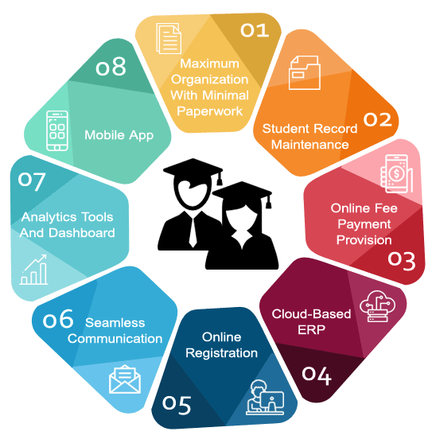
Benefits To The Institution
Student Repository System has revolutionized the way of education not only by building a technological font but by making it effective and easily accessible for users in remote locations.
Cost effective and time saving as it reduces paper works and saves resources. Empowers staff by training them and making them innovative educators. Can effortlessly issue updated report cards, manage student's transcripts and obtain any information on the go. Descriptive dashboards that makes it easier for faculties to evaluate trends that determine student’s performances. Cloud based ERP with secured database updates and improves the associated system. Ease of managing the courses for students based on specializations etc. Managing attendance and scheduling other events and assignments.

Slide 4
Technology used:
Front-End Technology → HTML, CSS, JavaScript, React Framework. Back-End Technology → J2EE Framework, Spring Framework. Database → MongoDB

Slide 5
Benefits To The Students:
Personalized student profile. Easy to keep track of performance and scheduling required time table based on the data. Hassle free admission procedures. Digitization helps them understand the dynamics of technology. Associated tools with assessments helps the students asses their forte and thereby acts as a virtual guidance counselor.

Slide 6
Benefits To The Teachers:
Personalized student profile. Easy to keep track of performance and scheduling required time-table based on the data. Hassle free admission procedures. Digitization helps them understand the dynamics of technology. Associated tools with assessments helps the teachers to manage and maintain student’s data easily.

Slide 7
Benefits To The Parents:
Personalized child profile. Easy to keep track of performance and scheduling required time-table based on the data. Hassle free admission procedures. Can track their child’s progress real time anytime anywhere.

Slide 8
THANK YOU

